Slide 1






























Home
Staff
Exam Report
Library
Timetable
Logins
Help
Students
Classes
Report Card
Transactions
Subjects
Schedule
Admin

Slide 2
































Home
Staff
Exam Report
Transport
Hostel
Timetable
Login
Library
Help
School/College Management
Students
Classes
Report Card
Transactions
Schedule
Subjects
Schedule
Admin

Slide 3












Students
Select Student:
Add Pic
Search by ID:
Del Pic
Search by Phone:
Search by Email:
Clear Pic
General Info
Fee & Payments
Attendance
Exams
ID Card
Transfer Certifcate
More
Clear
Program/Class
Session
Section
First Name:
Last Name::
Student ID:
Address
Birthdate:
City:
State & Zip:
Gender:
Level/Grade:
Email:
Phone No:
Parent 1:
Parent Email:
Parent Phone:
Parent 2:
Parent Email:
Parent Phone:
Admission Date:
Tuition Fee:
Frequency:
Transport Fee:
Library Fee:
Admis. Fee:
Total Fee:
Total Paid:
Balance
New Student
Delete Student
UpdateStudent

Slide 4
Shift Data
Select Class:
Select Session:
Clear Existing
Shift Data

Slide 5




BAPTIST VOICE BIBLE COLLEGE
Home
Staff
Exam Report
Transport
Hostel
Library
Timetable
Logins
Help
Add/Pan Card
Classes
Report Card
Transactions
Schedule
Subjects
Schedule
Admin

Slide 6
Acknowledge Group of Colleges Noor Shah Campus Sahiwal
Home
Staff
Exam Report
Transport
Hostel
Library
Timetable
Logins
Help
التلاميذ/الطلبة
الأقسام الدراسية
بيان النتائج
المداخيل
المقررات
المواضيع
Schedule
المشرف

Slide 7
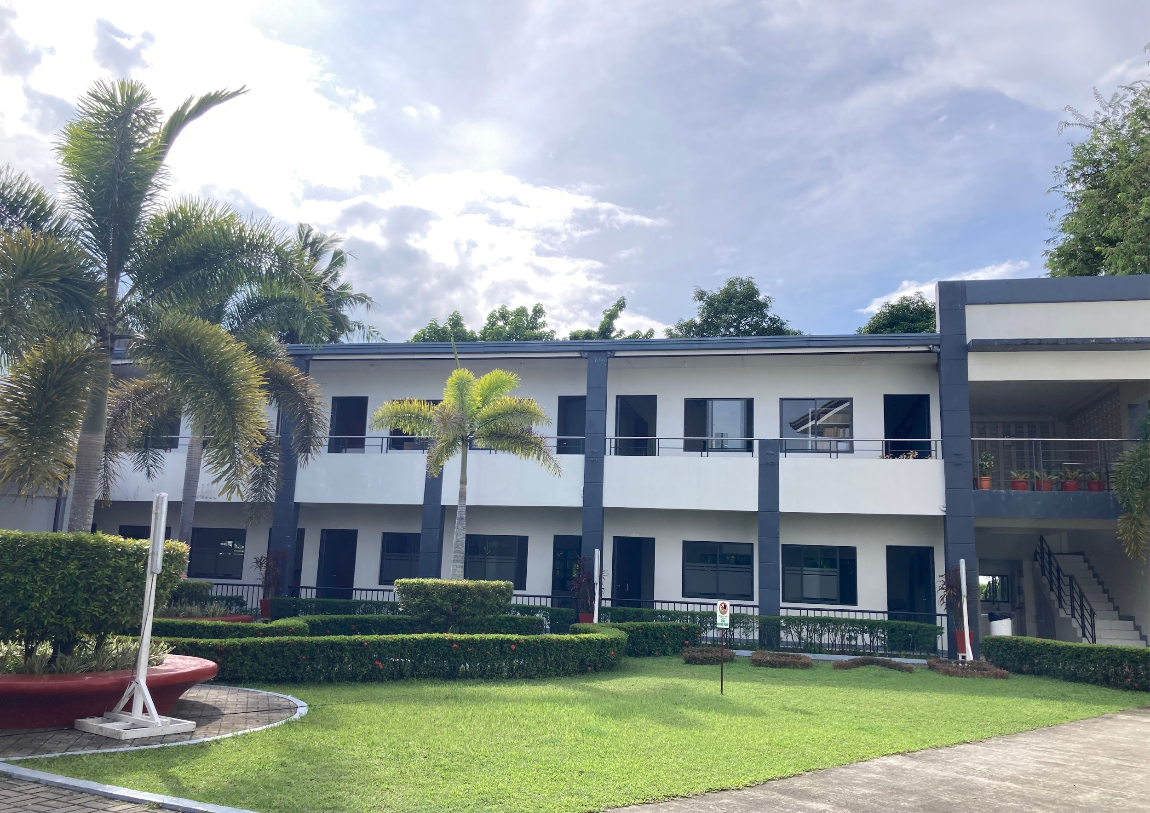

3224
LogIn
Cancel

Slide 8
SPS GOJRA
3224

Slide 9











Password Login MS BCOM BAFM BAFE Faculty C.Code Orders Joining Bills Attendance Notifications Dispatch
Search Std
Add
C. Code
Joining
Bills
Search Doc
Ad. Login
Cr/UP
Close App
Log ff

Slide 10



Welc ome back!
masuum
SIGN IN
Cancel

Slide 11







SELAMAT DATANG
YYkk
YY
Save Data
Exit Form

Slide 12

Welcome Back !
Save Data
Exit Form
Clear Data

Slide 13






Welcome Back !
MD MASUM
HE
Save Data
Exit Form
Clear Data

Slide 14

WELCOME BACK !
Imtiaz
Save Data
Exit Form
Clear Data

Slide 15
Welcome Back !
Save Data
Clear Data
Exit Form

Slide 16














Slide 18










cc
To
Name | Education | Role | Period
1.1.2022
ccc
Asraful
cccxx
Education
xcxzxz
asv
szxzc xc
1234
cx xczxxzx
12
zczxxz
Add
Clear
Update
Search Employee by Name:
Additional Control:
Search Employee by Education:

Slide 19
Joining Date
To
Name
Education
Username
Password
Role
Add
Clear
Update
Search Employee by Name:
Additional Control:
Search Employee by Education:

Slide 20




Start Session

Slide 21
Start Session
Notes:
i like it

Slide 22
Start Session

Slide 23













Skid Management System
STAR DATE:
END DATE:
Products Manager
Save
Order Received
Dispatched
Total Amount
In stock
Billing amount
List of Available Stock
Record Sale/Purchase Transactions
Search:
Product Name:
Quantity:
Date:
Refresh
Extract
Entry Type:
Rate:
Add
Update
Show Transactions:
All
Sale
Purchase
Extract

Slide 24
Skid Management System
STAR DATE:
END DATE:
Products Manager
Save
Order Received
Dispatched
Total Amount
In stock
Billing amount
List of Available Stock
Record Sale/Purchase Transactions
Search:
Product Name:
Quantity:
Date:
Refresh
Extract
Entry Type:
Rate:
Add
Update
Show Transactions:
All
Sale
Purchase
Extract

Slide 25
Welcome back!
SIGN IN
Cancel

Slide 26
WELCOME BACK!
kk
Save Data
Exit Form

Slide 27
Welcome Back !
Save Data
Exit Form
Clear Data

Slide 28
Welcome Back !
Save Data
Exit Form
Clear Data

Slide 29
WELCOME BACK !
Save Data
Exit Form
Clear Data

Slide 32
To
Name | Education | Role | Period
Joining Date
Name
Education
Username
Password
Role
Add
Clear
Update
Search Employee by Name:
Additional Control:
Search Employee by Education:

Slide 33
Joining Date
To
Name
Education
Username
Password
Role
Add
Clear
Update
Search Employee by Name:
Additional Control:
Search Employee by Education:

Slide 34
Joining Date
To
Name
Education
Username
Password
Role
Add
Clear
Update
Search Employee by Name:
Additional Control:
Search Employee by Education:

Slide 35
Joining Date
To
Name
Education
Username
Password
Role
Add
Clear
Update
Search Employee by Name:
Additional Control:
Search Employee by Education:

Slide 36
Start Session

Slide 37
Start Session

Slide 38
Start Session

Slide 39
Skid Management System
STAR DATE:
END DATE:
Products Manager
Save
Order Received
Dispatched
Total Amount
In stock
Billing amount
List of Available Stock
Record Sale/Purchase Transactions
Search:
Product Name:
zzz
Quantity:
Date:
Refresh
Extract
Entry Type:
Rate:
Add
Update
Show Transactions:
All
Sale
Purchase
Extract

Slide 40
Welcome back!
SIGN IN
Cancel

Slide 41
WELCOME BACK!
kk
Save Data
Exit Form

Slide 42
Welcome Back !
Save Data
Exit Form
Clear Data

Slide 43
Welcome Back !
Save Data
Exit Form
Clear Data

Slide 44
Skid Management System
STAR DATE:
END DATE:
Products Manager
Save
Order Received
Dispatched
Total Amount
In stock
Billing amount
List of Available Stock
Record Sale/Purchase Transactions
Search:
Product Name:
Quantity:
Date:
Refresh
Extract
Entry Type:
Rate:
Add
Update
Show Transactions:
All
Sale
Purchase
Extract

Slide 45
Welcome Back !
Save Data
Exit Form
Clear Data

Slide 46
Welcome Back !
Save Data
Exit Form
Clear Data

Slide 47
WELCOME BACK !
Save Data
Exit Form
Clear Data

Slide 50
To
Name | Education | Role | Period
Joining Date
Name
Education
Username
Password
Role
Add
Clear
Update
Search Employee by Name:
Additional Control:
Search Employee by Education:

Slide 51
Joining Date
To
Name
Education
Username
Password
Role
Add
Clear
Update
Search Employee by Name:
Additional Control:
Search Employee by Education:

Slide 52
Start Session

Slide 53
Start Session

Slide 54
Start Session

Slide 55
Skid Management System
STAR DATE:
END DATE:
Products Manager
Save
Order Received
Dispatched
Total Amount
In stock
Billing amount
List of Available Stock
Record Sale/Purchase Transactions
Search:
Product Name:
Quantity:
Date:
Refresh
Extract
Entry Type:
Rate:
Add
Update
Show Transactions:
All
Sale
Purchase
Extract

Slide 56
WELCOME BACK

Slide 57
Skid Management System
STAR DATE:
END DATE:
Products Manager
Save
Order Received
Dispatched
Total Amount
In stock
Billing amount
List of Available Stock
Record Sale/Purchase Transactions
Search:
Product Name:
Quantity:
Date:
Refresh
Extract
Entry Type:
Rate:
Add
Update
Show Transactions:
All
Sale
Purchase
Extract

Slide 58
WELCOME BACK !
Save Data
Exit Form
Clear Data

Slide 61
fgf
To
Name | Education | Role | Period
Joining Date
Name
Education
Username
Password
Role
Add
Clear
Update
Search Employee by Name:
Additional Control:
Search Employee by Education:

Slide 62
Joining Date
To
Name
Education
Username
Password
Role
Add
Clear
Update
Search Employee by Name:
Additional Control:
Search Employee by Education:

Slide 63
Start Session

Slide 64
Start Session

Slide 65
Start Session

Slide 66
Skid Management System
STAR DATE:
END DATE:
Products Manager
Save
Order Received
Dispatched
Total Amount
In stock
Billing amount
List of Available Stock
Record Sale/Purchase Transactions
Search:
Product Name:
Quantity:
Date:
Refresh
Extract
Entry Type:
Rate:
Add
Update
Show Transactions:
All
Sale
Purchase
Extract

Slide 67
Skid Management System
STAR DATE:
END DATE:
Products Manager
Save
Order Received
Dispatched
Total Amount
In stock
Billing amount
List of Available Stock
Record Sale/Purchase Transactions
Search:
Product Name:
Quantity:
Date:
Refresh
Extract
Entry Type:
Rate:
Add
Update
Show Transactions:
All
Sale
Purchase
Extract

Slide 68
Skid Management System
STAR DATE:
END DATE:
Products Manager
Save
Order Received
Dispatched
Total Amount
In stock
Billing amount
List of Available Stock
Record Sale/Purchase Transactions
Search:
Product Name:
Quantity:
Date:
Refresh
Extract
Entry Type:
Rate:
Add
Update
Show Transactions:
All
Sale
Purchase
Extract

Slide 69
Skid Management System
STAR DATE:
END DATE:
Products Manager
Save
Order Received
Dispatched
Total Amount
In stock
Billing amount
List of Available Stock
Record Sale/Purchase Transactions
Search:
Product Name:
Quantity:
Date:
Refresh
Extract
Entry Type:
Rate:
Add
Update
Show Transactions:
All
Sale
Purchase
Extract

Slide 70
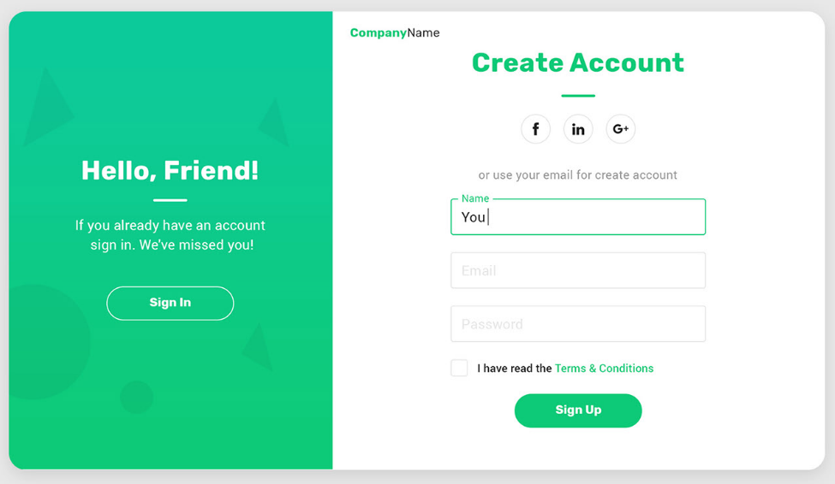

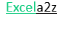
Name
Father Name
Email
User ID
Password
Next

Slide 71
Welcome back!
SIGN IN
Cancel

Slide 72
WELCOME BACK!
kk
Save Data
Exit Form

Slide 73
Welcome Back !
Save Data
Exit Form
Clear Data

Slide 74
Welcome Back !
Save Data
Exit Form
Clear Data

Slide 75
WELCOME BACK !
Save Data
Exit Form
Clear Data

Slide 78
To
Name | Education | Role | Period
Joining Date
Name
Education
Username
Password
Role
Add
Clear
Update
Search Employee by Name:
Additional Control:
Search Employee by Education:

Slide 79
Joining Date
To
Name
Education
Username
Password
Role
Add
Clear
Update
Search Employee by Name:
Additional Control:
Search Employee by Education:

Slide 80
Start Session

Slide 81
Start Session

Slide 82
Start Session

Slide 83
Skid Management System
STAR DATE:
END DATE:
Products Manager
Save
Order Received
Dispatched
Total Amount
In stock
Billing amount
List of Available Stock
Record Sale/Purchase Transactions
Search:
Product Name:
Quantity:
Date:
Refresh
Extract
Entry Type:
Rate:
Add
Update
Show Transactions:
All
Sale
Purchase
Extract

Slide 84
Skid Management System
STAR DATE:
END DATE:
Products Manager
Save
Order Received
Dispatched
Total Amount
In stock
Billing amount
List of Available Stock
Record Sale/Purchase Transactions
Search:
Product Name:
Quantity:
Date:
Refresh
Extract
Entry Type:
Rate:
Add
Update
Show Transactions:
All
Sale
Purchase
Extract

Slide 85

- - - Product Manager (Add or Update Products) - - -
Product Name:
Purchase Price:
Sale Price:
Add
Update
Extract

Slide 86



Login Form
Login

Slide 87


















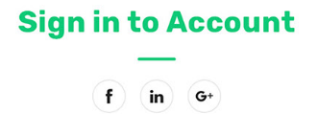






Excel
a2z
Hello Friends
Fill up personal information and start journey with us
or use your account details
User ID
Password
Sign Up
Remember me
Forgot Password?
Sign In
Privacy Policy Terms & Conditions

Slide 88








Jacky2Tech
Solutions 2021
Sign into account
Hello Friends !
Or user your account details
Fill up personal information and start journey with us
User ID
Password
Signup
Remember me
Forgot password?
Sign in

Slide 89
Name
Father Name
Email
User ID
Password
Next

Slide 90
Name
Father Name
Email
User ID
Password
Next

Slide 91
Start Session

Slide 92
Start Session

Slide 93
Start Session

Slide 94
Skid Management System
STAR DATE:
END DATE:
Products Manager
Save
Order Received
Dispatched
Total Amount
In stock
Billing amount
List of Available Stock
Record Sale/Purchase Transactions
Search:
Product Name:
Quantity:
Date:
Refresh
Extract
Entry Type:
Rate:
Add
Update
Show Transactions:
All
Sale
Purchase
Extract

Slide 95
Skid Management System
STAR DATE:
END DATE:
Products Manager
Save
Order Received
Dispatched
Total Amount
In stock
Billing amount
List of Available Stock
Record Sale/Purchase Transactions
Search:
Product Name:
Quantity:
Date:
Refresh
Extract
Entry Type:
Rate:
Add
Update
Show Transactions:
All
Sale
Purchase
Extract

Slide 96

Enter Employment Record
Company Name :
Designation :
Duration: From :__________
To :________
🡨 Back
Add
Add more

Slide 97
Start Session

Slide 98
Start Session

Slide 99
Start Session

Slide 100
Skid Management System
STAR DATE:
END DATE:
Products Manager
Save
Order Received
Dispatched
Total Amount
In stock
Billing amount
List of Available Stock
Record Sale/Purchase Transactions
Search:
Product Name:
Quantity:
Date:
Refresh
Extract
Entry Type:
Rate:
Add
Update
Show Transactions:
All
Sale
Purchase
Extract

Slide 101
Skid Management System
STAR DATE:
END DATE:
Products Manager
Save
Order Received
Dispatched
Total Amount
In stock
Billing amount
List of Available Stock
Record Sale/Purchase Transactions
Search:
Product Name:
Quantity:
Date:
Refresh
Extract
Entry Type:
Rate:
Add
Update
Show Transactions:
All
Sale
Purchase
Extract

Slide 102
Enter Employment Record
Company Name :
Designation :
Duration: From :__________
To :________
🡨 Back
Add
Add more

Slide 103
Enter Employment Record
Company Name :
Designation :
Duration: From :__________
To :________
🡨 Back
Add
Add more

Slide 104

🡨 Back
Add
Add More

Slide 105




Slide 106











Slide 107





Welcome to App Selection Center
Staff App
Stock App
Store App
Hotel App
Edu. App
POS App

Slide 108














STAFF MANAGEMENT SYSTEM
Search by Name:
Search by Contact:
Basic Salary:
Bank Name:
Home Allowance:
Bank Account:
Medical Allowance:
Branch Code :
Traveling Allowance:
IBAN No.:
Show/Hide
Delete
Cancel
Update
Add

Slide 109
























STAFF MANAGEMENT SYSTEM
Search by Name:
Search by Contact:
Name:
Designation:
Department:
Email:
Contact:
DOJ :
Status:
DOL:
Show/Hide
Delete
Cancel
Update
Add

Slide 111





























STAFF MANAGEMENT SYSTEM
Search by Name:
Search by Contact:
Father Name:
DOB:
Blood Group:
Emergency Contact:
Relation:
CNIC:
Relation:
Address:
Education Level:
Show/Hide
Delete
Cancel
Update
Add

Slide 112













Slide 113












Smart Attendance Manager
Date:
Emp ID:
Attendance:
Mark
Update
Photo
Filter:
Sort:
Export:

Slide 114

Smart Attendance Manager
Date:
Emp ID:
Attendance:
Mark
Update
Photo
Filter:
Sort:
Export:

Slide 115





Smart Attendance Manager
Date:
Emp ID:
Attendance:
Mark
Update
Photo
Emp Name:
Export to:
Clear
Mark Bulk Att.:
Select Date:
Select Attendance:
Mark

Slide 116





Smart Attendance Manager
Add Attendance Code
Att. Code Details
Add Attendance in Register
Attendance Code:
Start Date
Attendance Type:
End Date:
Remarks:
Note: Existing Record will be replaced
Update Register
Clear
Check Date on Att. Register
Add
Update
Clear

Slide 117
Smart Attendance Manager
Attendance Code:
Attendance Type:
Remarks:
Add
Update
Mark Bulk Attendance
Date:
Attendance:
Add

Slide 118
Welcome on board!
Login ID:
Password :
🡨 Exit
Login
Clear 🡪
Sign in with

Slide 119
Welcome Back!
User ID
Password
🡨 Exit
Login
Clear ->

Slide 120



Login ID:
Password:
Get In

Slide 121


































Doctors
Admit Patient
Ambulance
Medicines
Nurses
Support Staff
Appointments
Message
Notification
Setting
Appointment
Admit Patient
LAB Reports
Billing
Room Mgt
Operation Theater
Patient Report
Inventory
Discharge Summary
Covid-19 Patient
Payment Reports
Ambulance Mgt
Doctors Mgt
Shift Mgt
Laboratory Mgt
Blood Bank
Patient Report

Slide 122












Appointment Booking For New or Returning Patients
Patient Details
Patient ID:
Patient Name:
Patient Phone:
Patient Email:
Patient Issue #
Patient Visit #:
Guardian Details
Guard. Name
Guard Relation:
Guard. Phone:
Guard Email:
Guard. Address:
Doctor & Payment Details
Dr. Requested:
Booking Date:
Appoint. Date:
Appoint. Time:
Checkup Fee
Fee Received:
Book Now
Reset From
Other
Booked By:_________

Slide 123









Add New Ward/Room/Bed
Add Details Here
Ward Name:
Room No.:
Bed No.:
Total
Wards = ____ Rooms = ____ Beds = ____
Room Rate:
Filter By:
Search
Reset Filter
Add Now
Reset From
Update

Slide 124


Admit Patient
Available Rooms:
Search
Reset Filter
Select Patient
Search
Reset Filter
Ward/Room/Bed Name:
Patient Name:
Admit
Reset From

Slide 125



Slide 126
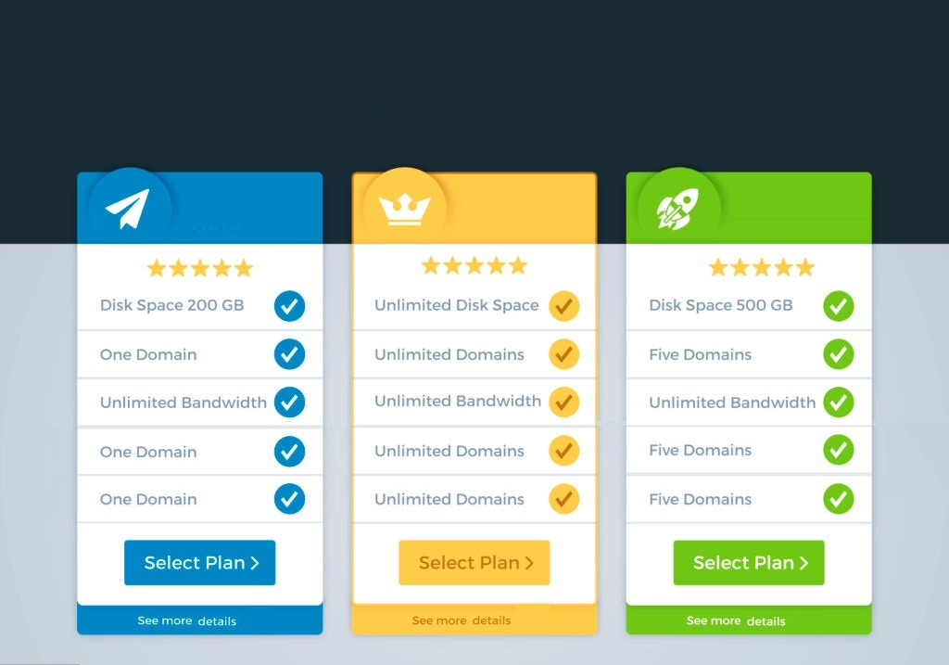



Total Stock Qty
Total Stock Rs.
Low Stock Alert
Purchase
Sale
Stock
Add Supplier
Create Invoice
Add Category/Product
Pay to Supplier
Add Customer
Low Stock Products
Add Category/Product
Track Invoice
Expiring Products
Search Product
Print Invoice
Slow Moving Product
Supplier Ledger
Sale Ledger
Stok Report
Go In
Go In
Go In

Slide 127


















Vendor
Category
Product
Supplier Ledger
Name:
________fgg__
P_Type:
__________
Invoice #:
__________
Address:
__________
Product:
__________
Vendor:
__________
Phone:
__________
P_Code:
__________
Amount:
__________
Email:
__________
Date:
__________
GST #:
__________
Method:
__________
Go In
Go In
Go In
Add
Update
Clear
Add
Update
Clear
Add
Update
Clear

Slide 128
















Inventory Manager
HOME
Welcome Back:
Login ID:
Password:
Supplier
Forgot Pass?
Login
Clear
Quick Links
Make a Sale
Add Product
Sale
Purchase
Add Vendor
Make Payment
Stock Report

Slide 129

Inv Manager
HOME
Sale
Sale
Purchase
Add
Vendor

Slide 130

Vendor Area/Add New Vendor
Vendor ID:
Phone No.:
Add New
Update
Name:
Email ID:
Delete
Address:
GST #:
<< Back
Search:
Clear
View All

Slide 131
Add Category/Product
Vendor ID:
Phone No.:
Add New
Update
Name:
Email ID:
Delete
Address:
GST #:
<< Back
Search:
Clear
View All

Slide 132
ITEM CODE GENERATOR
Project :
Client :
RFIPL WO No. :
Client Email Id:
Department:
Region :
Document:
Indentor :
Open Datet:
Lead Time:
Item Code :
Filter
Packing
Qty
Free Qty
GST
Exp Date
In Stock
Submit
Clear
Add Category
View All
Update
Delete
Submit Data
<< Back
Sub Total
After Discount
GST
Total Value

Slide 133







Sale/Invoice Area
Bill Date
Bill No.
Customer Name
Add New
Sale Type
In Stock
Item Type
Payment Type
Total Bill
Payment
Product Name
Add New
It. Code
It. Price
It. Qty
Discount
Add to Cart
50
10000
100
5000
200
2000
500
1000
Change
Cart items
Save Bill
Print Bill
Clear Cart
<< Back
Send SMS
Send eMail
Powered by: Excel a2z v1.0

Slide 134




Welcome Dost!
Let's Start

Slide 135







Home
School/College/Campus Manager
Students
Classes
Report Card
Transactions
ali
cs
monday

Slide 136


Students
Select Student:
Add Pic
Current Program:
Del Pic
Current Session:
Current Section:
Clear Pic
General Info
Fee & Payments
Attendance
Exams
ID Card
Type
Date
Amount
Term
Notes
Other
New Pay/Fee
Delete Pay/Fee
Update pay/Fee

Slide 137
STRUKTUR BADAN PENGURUS ASRAMA PULEMDIR
Asok wesapla
jhonan wesapla
Koni weipsa
Rocky kwambu
kegiatan
Pinna meklok
Nikson kwambu
Manias wesapla

Slide 138


Home
Home
Home
Home
School Management
Students
Students
Students
Students
Students
Students
Students
Students
Students

Slide 139

Students
Select Students:
Add Photo
Search by ID:
Del Photo
Search by Phone:
Search by Email:
Clear Photo
General Info
Fee & payments
Atandence
Exams
Carte ID
Programme/Classe
Session:
Section:
Name:
Father Name:
Student ID:
Adresse:
D-O-B:
City:
Zip Code:
Gender/Sex:
Level/Grade:
Email:
Phone No:
Parent 1:
Parent 1 Email:
Parent Phone
Parent 2:
Parent 2 Email:
Parent Phone
Admission Date:
Toetion Fee:
Frequency::
Transport Fee:
Library Fee:
Adm Fee:
Total Fee:
Total Fee:
Balance:
Add Student
Delete Student.
Update Student

Slide 140
Password Login MS BCOM BAFM BAFE Faculty C.Code Orders Joining Bills Attendance Notifications Dispatch
Search Std
Add
C. Code
Joining
Bills
Search Doc
Ad. Login
Cr/UP
Close App
Log ff

Slide 141
WELCOME BACK!
Save Data
Exit Form
Clear Data

Slide 142
Welcome Back !
Save Data
Exit Form
Clear Data

Slide 143
Welcome Back !
Save Data
Exit Form
Clear Data

Slide 144
WELCOME BACK !
Save Data
Exit Form
Clear Data

Slide 145
Welcome Back !
Save Data
Clear Data
Exit Form

Slide 147
To
Name | Education | Role | Period
Joining Date
Name
Education
Username
Password
Role
Add
Clear
Update
Search Employee by Name:
Additional Control:
Search Employee by Education:

Slide 148
Joining Date
To
Name
Education
Username
Password
Role
Add
Clear
Update
Search Employee by Name:
Additional Control:
Search Employee by Education:

Slide 149
Start Session

Slide 150




- - - Stock Management System v1.0 - - -
STAR DATE:
END DATE:
Products Manager
Save
Purchase
Sale
Profit
Inventory QTY
Inventory amount
List of Available Stock
Record Sale/Purchase Transactions
Search:
Product Name:
Quantity:
Date:
Refresh
Extract
Transaction Type:
Rate:
Add
Update
Show Transactions:
All
Sale
Purchase
Extract

Slide 151
- - - Product Manager (Add or Update Products) - - -
Product Name:
Purchase Price:
Sale Price:
Add
Update
Extract

Slide 152
Login Form
Login

Slide 153
Jacky2Tech Solutions
Hello Friends
Fill up personal information and start journey with us
or use your account details
User ID
Password
Sign Up
Remember me
Forgot Password?
Sign In
Privacy Policy Terms & Conditions

Slide 154
Excel
a2z
Sign into account
Hello Friends !
Or user your account details
Fill up personal information and start journey with us
User ID
Password
Signup
Remember me
Forgot password?
Sign in

Slide 155
Name
Father Name
Email
User ID
Password
Next

Slide 156
Name
Father Name
Email
User ID
Password
Next

Slide 157
Enter Employment Record
Company Name :
Designation :
Duration: From :__________
To :________
🡨 Back
Add
Add more

Slide 158
🡨 Back
Add
Add More

Slide 161
Welcome to App Selection Center
Staff App
Stock App
Store App
Hotel App
Edu. App
POS App

Slide 162
STAFF MANAGEMENT SYSTEM
Search by Name:
Search by Contact:
Basic Salary:
Bank Name:
Home Allowance:
Bank Account:
Medical Allowance:
Branch Code :
Traveling Allowance:
IBAN No.:
Show/Hide
Delete
Cancel
Update
Add

Slide 163
STAFF MANAGEMENT SYSTEM
Search by Name:
Search by Contact:
Name:
Designation:
Department:
Email:
Contact:
DOJ :
Status:
DOL:
Show/Hide
Delete
Cancel
Update
Add

Slide 164
STAFF MANAGEMENT SYSTEM
Search by Name:
Search by Contact:
Father Name:
DOB:
Blood Group:
Emergency Contact:
CNIC:
Relation:
Address:
Education Level:
Show/Hide
Delete
Cancel
Update
Add

Slide 166
Smart Attendance Manager
Date:
Emp ID:
Attendance:
Mark
Update
Photo
Filter:
Sort:
Export:

Slide 167
Smart Attendance Manager
Date:
Emp ID:
Attendance:
Mark
Update
Photo
Filter:
Sort:
Export:

Slide 168
Smart Attendance Manager
Date:
Emp ID:
Attendance:
Mark
Update
Photo
Emp Name:
Export to:
Clear
Mark Bulk Att.:
Select Date:
Select Attendance:
Mark

Slide 169
Smart Attendance Manager
Add Attendance Code
Att. Code Details
Add Attendance in Register
Attendance Code:
Start Date
Attendance Type:
End Date:
Remarks:
Note: Existing Record will be replaced
Update Register
Clear
Check Date on Att. Register
Add
Update
Clear

Slide 170
Smart Attendance Manager
Attendance Code:
Attendance Type:
Remarks:
Add
Update
Mark Bulk Attendance
Date:
Attendance:
Add

Slide 171
Welcome on board!
Login ID:
Password :
🡨 Exit
Login
Clear 🡪
Sign in with

Slide 172
Welcome Back!
User ID
Password
🡨 Exit
Login
Clear ->

Slide 173

Login ID:
Password:
Get In

Slide 174
Doctors
Admit Patient
Ambulance
Medicines
Nurses
Support Staff
Appointments
Message
Notification
Setting
Appointment
Admit Patient
LAB Reports
Billing
Room Mgt
Operation Theater
Patient Report
Inventory
Discharge Summary
Covid-19 Patient
Payment Reports
Ambulance Mgt
Doctors Mgt
Shift Mgt
Laboratory Mgt
Blood Bank
Patient Report

Slide 175
Appointment Booking For New or Returning Patients
Patient Details
Patient ID:
Patient Name:
Patient Phone:
Patient Email:
Patient Issue #
Patient Visit #:
Guardian Details
Guard. Name
Guard Relation:
Guard. Phone:
Guard Email:
Guard. Address:
Physician Details
Dr. Requested:
Booking Date:
Appoint. Date:
Appoint. Time:
Checkup Fee
Fee Received:
Book Now
Reset From
Other
Booked By:_________

Slide 176
Add New Ward/Room/Bed
Add Details Here
Ward Name:
Room No.:
Bed No.:
Total
Wards = ____ Rooms = ____ Beds = ____
Room Rate:
Filter By:
Search
Reset Filter
Add Now
Reset From
Update

Slide 177
Admit Patient
Available Rooms:
Search
Reset Filter
Select Patient
Search
Reset Filter
Ward/Room/Bed Name:
Patient Name:
Admit
Reset From

Slide 179
Total Stock Qty
Total Stock Rs.
Low Stock Alert
Purchase
Sale
Stock
Add Supplier
Create Invoice
Add Category/Product
Pay to Supplier
Add Customer
Low Stock Products
Add Category/Product
Track Invoice
Expiring Products
Search Product
Print Invoice
Slow Moving Product
Supplier Ledger
Sale Ledger
Stok Report
Go In
Go In
Go In

Slide 180
Vendor
Category
Product
Supplier Ledger
Name:
__________
P_Type:
__________
Invoice #:
__________
Address:
__________
Product:
__________
Vendor:
__________
Phone:
__________
P_Code:
__________
Amount:
__________
Email:
__________
Date:
__________
GST #:
__________
Method:
__________
Go In
Go In
Go In
Add
Update
Clear
Add
Update
Clear
Add
Update
Clear

Slide 181
Inventory Manager
HOME
Welcome Back:
Login ID:
Password:
Supplier
Forgot Pass?
Login
Clear
Quick Links
Make a Sale
Add Product
Sale
Purchase
Add Vendor
Make Payment
Stock Report

Slide 182
Inv Manager
HOME
Sale
Sale
Purchase
Add
Vendor

Slide 183
Vendor Area/Add New Vendor
Vendor ID:
Phone No.:
Add New
Update
Name:
Email ID:
Delete
Address:
GST #:
<< Back
Search:
Clear
View All

Slide 184
Add Category/Product
Vendor ID:
Phone No.:
Add New
Update
Name:
Email ID:
Delete
Address:
GST #:
<< Back
Search:
Clear
View All

Slide 185
Purchase Area
Product Type :
Product Specs:
M.R.P
Product Code :
Vendor:
Discount:
Company:
Purchase Price:
Wholesale:
Product Name:
Purchase Tax % :
Purchase Type:
Batch
Packing
Qty
Free Qty
GST
Exp Date
In Stock
Print
Clear
Add Category
View All
Update
Delete
Submit Data
<< Back
Sub Total
After Discount
GST
Total Value

Slide 186
Sale/Invoice Area
Bill Date
Bill No.
Customer Name
Add New
Sale Type
In Stock
Item Type
Payment Type
Total Bill
Payment
Product Name
Add New
It. Code
It. Price
It. Qty
Discount
Add to Cart
50
10000
100
5000
200
2000
500
1000
Change
Cart items
Save Bill
Print Bill
Clear Cart
<< Back
Send SMS
Send eMail
Powered by: Excel a2z v1.0

Slide 187
Welcome Dost!
Let's Start

Slide 188
School/College/Campus Manager
Home
Staff
Exam Report
Transport
Hostel
Library
Timetable
Logins
Help
Students
Classes
Report Card
Transactions
Schedule
Subjects
Schedule
Admin

Slide 189
School/College/Campus Manager
Home
Staff
Exam Report
Transport
Hostel
Library
Timetable
Logins
Help
Students
Classes
Report Card
Transactions
Schedule
Subjects
Schedule
Admin

Slide 190


S T U D E N T
Select Student:
Add Pic
Search by ID:
Del Pic
Search by Phone:
Search by Email:
Clear Pic
General Info
Fee & Payments
Attendance
Exams
ID Card
Transfer Certificate
More
Clear
Program/Class
Session:
Section:
First Name:
Last Name:
Student ID:
Address:
Birthdate:
City:
State & Zip:
Gender:
Level/Grade:
Email:
Phone No.:
Father’s Name:
Parent Email:
Parent Phone
Mother’s Name:
Parent Email:
Parent Phone
Admis. Date
Tuition Fee:
Admis. Fee:
Total Fee:
Total Paid:
Balance:
New Student
Delete Student
Update Student

Slide 191

Student Card
Home
Members
Exam Report
Providers
Select Student:
Add Pic
Search by ID:
Del Pic
Search by Phone:
Search by Email:
Clear Pic
General Info
Fee & Payments
Attendance
Exams
ID Card
Transfer Certificate
More
Get ID Card
Save ID Card
Clear
Excel a2z School System
Excel a2z School System
STUDENT
Name:
Address:
Phone:
Roll No:
Class:
Blood Grp:
Session:
Emrg. No.:
Guardian:
National:
Excel a2z: 330 Ocean Pkwy, Brooklyn NY 11218
Phone: 347-558 (1227)
Email: info@excela2z.com
Student ID Card
ID Card Front
ID Card Back

Slide 192
Student Card
Home
Staff
Exam Report
Transport
Hostel
Library
Timetable
Logins
Help
Select Student:
Add Pic
Search by ID:
Del Pic
Search by Phone:
Search by Email:
Clear Pic
Fee & Payments
Attendance
Exams
ID Card
Transfer Certificate
More
Get ID Card
Save ID Card
Clear
Excel a2z School System
Excel a2z School System
STUDENT
Excel a2z: 330 Ocean Pkwy, Brooklyn NY 11218
Phone: 347-558 (1227)
Email: info@excela2z.com
Student ID Card
ID Card Front
ID Card Back

Slide 193


Student Card
Home
Staff
Exam Report
Transport
Hostel
Library
Timetable
Logins
Help
Select Student:
Add Pic
Search by ID:
Del Pic
Search by Phone:
Search by Email:
Clear Pic
Fee & Payments
Fee & Payments
Attendance
Exams
ID Card
Transfer Certificate
More
Get ID Card
Save ID Card
Clear
Excel a2z School System
Excel a2z School System
STUDENT
Name:
Address:
Phone:
Roll No:
Class:
Blood Group
Emrg.No
Session:
National:
Guardian
Excel a2z: 330 Ocean Pkwy, Brooklyn NY 11218
Phone: 347-558 (1227)
Email: info@excela2z.com
Student ID Card
ID Card Front
ID Card Back

Slide 194


Home
Hallmark Education System
Students
Classes
Report Card
Transactions
Schedule
Subjects
Schedule
Admin

Slide 196
Members Face Page
Physician Details
Relation:
Emergency Contact:
Member Name:
Start Date
Add Pic
Medicaid #:
End Date:
Del Pic
Date of Birth:
Diagnosis Code:
Clear Pic
General Info
Fee & Payments
Attendance
Exams
ID Card
Transfer Certificate
More
Clear
Program/Class
Session:
Section:
First Name:
Last Name:
Student ID:
Address:
Birthdate:
City:
State & Zip:
Gender:
Level/Grade:
Email:
Phone No.:
Father’s Name:
Parent Email:
Parent Phone
Mother’s Name
Parent Email:
Parent Phone
Admis. Date
Tuition Fee:
Admis. Fee:
Total Fee:
Total Paid:
Balance:
Delete Student
New Student
Delete Member
Update Student

Slide 197
Student Card
Home
Staff
Exam Report
Transport
Hostel
Library
Timetable
Logins
Help
Select Student:
Add Pic
Search by ID:
Del Pic
Search by Phone:
Search by Email:
Clear Pic
General Info
Fee & Payments
Attendance
Exams
ID Card
Transfer Certificate
More
Get ID Card
Save ID Card
Clear
Excel a2z School System
Excel a2z School System
STUDENT
Name:
Address:
Phone:
Roll No:
Class:
Blood Grp:
Session:
Emrg. No.:
Guardian:
National:
Excel a2z: 330 Ocean Pkwy, Brooklyn NY 11218
Phone: 347-558 (1227)
Email: info@excela2z.com
Student ID Card
ID Card Front
ID Card Back

Slide 198
Student Card
Home
Staff
Exam Report
Transport
Hostel
Library
Timetable
Logins
Help
Select Student:
Add Pic
Search by ID:
Del Pic
Search by Phone:
Search by Email:
Clear Pic
Fee & Payments
Attendance
Exams
ID Card
Transfer Certificate
More
Get ID Card
Save ID Card
Clear
Excel a2z School System
Excel a2z School System
STUDENT
Excel a2z: 330 Ocean Pkwy, Brooklyn NY 11218
Phone: 347-558 (1227)
Email: info@excela2z.com
Student ID Card
ID Card Front
ID Card Back

Slide 199




Student Card
Home
Staff
Exam Report
Transport
Hostel
Library
Timetable
Logins
Help
Select Student:
Select Class:
Add Pic
Search by ID:
Select Year/Test:
Del Pic
Search by Phone:
Exam/Test Date:
Search by Email:
Std.DOB:
Clear Pic
Fee & Payments
Attendance
Exams
ID Card
Transfer Certificate
More
ENTER STUDENT MARKS BELOW
Course Name
Code
Total Marks
Obtained
Percentage
Pass/all
Remarks
Total Students in class
Shift Data
Save
This Std Marks in Year l
Avg Marks of class in year 1
This Std Marks in Year ll
Avg Marks of class in year 2
Enable Edit
Reset
This Std Marks in Test l
Avg Marks in test 1
This Std Marks in Test ll
ID Card Back

Slide 200
Students
Select Student:
Add Pic
Current Program:
Del Pic
Current Session:
Current Section:
Clear Pic
General Info
Fee & Payments
Attendance
Exams
ID Card
Type
Date
Amount
Term
Notes
Other
New Pay/Fee
Delete Pay/Fee
Update pay/Fee

Slide 201
Students
Select Student:
Add Pic
Current Program:
Del Pic
Current Session:
Current Section:
Clear Pic
General Info
Fee & Payments
Attendance
Exams
ID Card
Type
Date
Amount
Term
Notes
Other
New Pay/Fee
Delete Pay/Fee
Update pay/Fee

